Slide 1
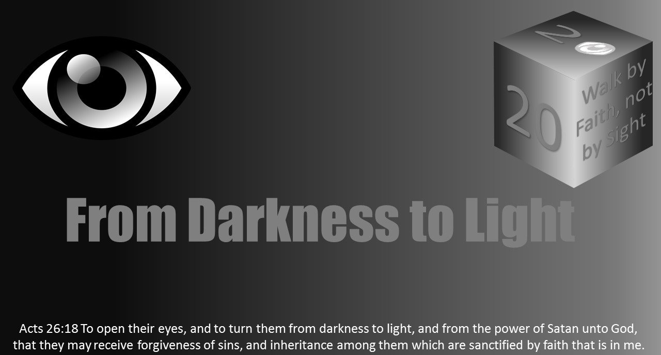


Slide 2
Light Lesson 10 Visual Perception: How Wise Are You in Your Eyes?

Slide 3

Introduction
The fear of the Lord is the beginning of knowledge; fools despise wisdom and instruction. Proverbs 1:7
How do you see your wisdom in comparison to God’s wisdom?
Are you blinded by your own experiences, accomplishments, and knowledge when it comes to deciding on an appropriate response in a scenario requiring an application of Godly wisdom?
Notes:
If you’re unfamiliar with what an Escape Room is, it is simply a problem-solving board game played out in real life.
People are paying companies to lock themselves in a room to see if they can get out by solving various brainteasers.
This is how much we enjoy problem solving; we are willing to be locked in a room by strangers to prove our intelligence.
This is how much we like to show our wisdom to others. This is how much we enjoy the satisfaction of providing the solution.

Slide 4
Introduction
Problem solving is something most people enjoy engaging. Whether it is scientific, mathematical, mechanical, simple, difficult, emotional, familial, we enjoy giving our input. Why?
Whether we are drawing from our personal experience, research, or academics, we believe we have a helpful (and more commonly the best) solution.
We enjoy problem solving because there’s a sense of accomplishment when our solution is correct or helpful.
There is a sense of pride in being able to explain we encountered an issue but through careful reasoning, we were able to solve the problem.
We like to be seen as wise!
Now, do not misunderstand, providing guidance and solutions is not inherently wrong; in fact it is even encouraged when our intent is pure. Proverbs 19:20, James 3:17
If we are blinded by our own pride we, will be destroyed by what we perceive as being wise.
Be wise by fearing the Lord because our wisdom falters before God’s wisdom.

Slide 5
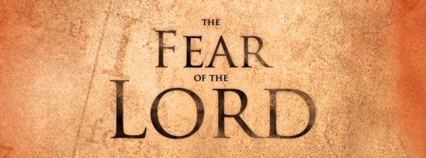
First Proof: Fear the Lord
Proverbs 1:7 and 9:10 provide an appropriate perspective toward progressing in wisdom.
Gaining wisdom does not begin with opening countless books. It does not start with memorizing biblical facts and reciting a defense on creation to an atheist or being able to refute countless doctrinal errors.
Our ability to see God’s wisdom more clearly before our own comes when we understand our position before Him – no one else.
Our pride is a major factor in visual perception. How we perceive ourselves and our knowledge will either cloud our visual perspective of God’s wisdom or allow us to submit resulting in true biblical transformation (Rom 12:1-2).

Slide 6
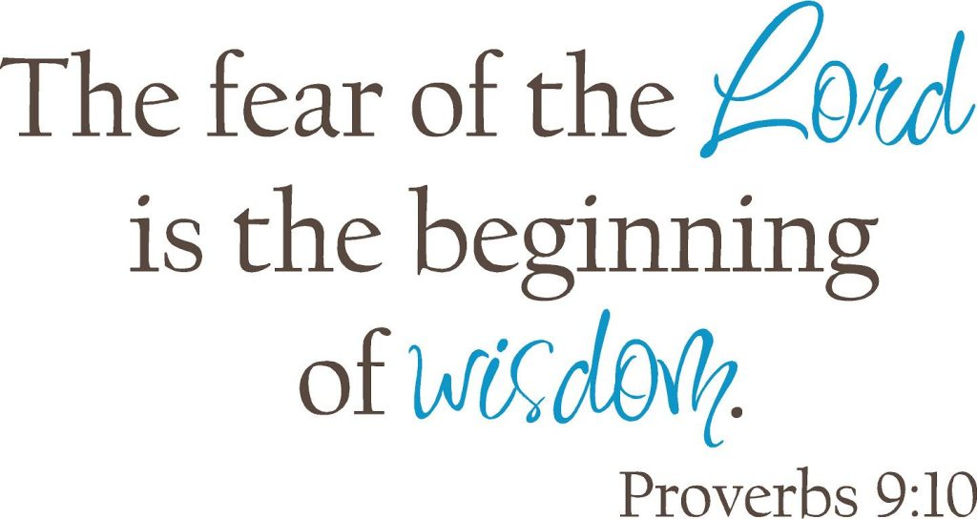
First Proof: Fear the Lord
Wisdom and knowledge are connected in the sense that a wise person learns how to apply knowledge in an appropriate manner.
The scriptures state “the fear of the Lord is the beginning knowledge…”
Knowledge leads to wisdom, wisdom leads to moral behavior and righteous decision making before the Lord.

Slide 7

First Proof: Fear the Lord
Kenneth Boa:
“Wisdom has less to do with knowledge than it has to do with the application of knowledge in very specific ways. Wisdom is a skill in the art of living life with each component under the dominion of God. When a person in the Old Testament demonstrated exceptional ability in a craft or art, that person was said to have what the Hebrew language calls hokma. English-speaking translators render it as “skill.” In Exodus 31:3-5, God filled a man named Bezalel with the Holy Spirit and with “skill, ability and knowledge in all kinds of crafts – to make artistic designs for work in gold, silver and bronze, to cut and set stones, to work in wood, and to engage in all kinds of craftsmanship.” The word translated “skill” here is this word hokma.

Slide 8
First Proof: Fear the Lord
Kenneth Boa continues:
Bezalel was given the ability to take raw materials and shape them into something beautiful and ornate. Likewise, in the book of Proverbs, we are viewed as that raw material. We are valuable but unshaped, worthwhile but undisciplined. We are precious but given to waywardness. We do not have within us the ability to take the raw material of our lives and shape it into the lifestyle our Creator desires us to live. Solomon selected that Hebrew word hokma to describe the quality needed by anyone who wanted to live life in the superlative – a life of excellence.”[1]
[1] Boa, Kenneth. Wisdom. Bible.Org,

Slide 9
First Proof: Fear the Lord
We have all encountered the individual who always has an answer, most commonly when we look in the mirror.
A “know it all” drives us nuts. Why? Two reasons:
either because we think we actually know the right answer
or because we know someone can not actually know it all.
If they did know it all, then we should go to them for all of our problems.
This is a dilemma because then we would have to trust this individual actually does know it all in order to actually follow through with their answers and guidance.
How can we trust someone so much that we communicate everything to them?
So, now it is not only about whether or not someone knows everything. It is about trusting whether they actually know everything and what they will do with the information relayed to them.
Who can do that?

Slide 10
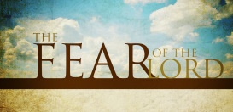
First Proof: Fear the Lord
Thus, the application is fear the Lord.
Proverbs 1:7 supports that if we do not fear the Lord we are fools.
Being wise men and women will be determined by whether or not we are seeking and fearing the Lord.
Learning to “fear the Lord”, as Proverbs instructs, is only the beginning.
We not only need to see that the Lord needs reverence, but as a clear connection our fear for the Lord is derived from knowing where wisdom begins.
Be wise! Fear the Lord!

Slide 11
Second proof: We are fools.
“And the people of Israel cried out for help to the Lord.” (Judges 6:6)
While this phrase may appear innocent and sincere, there’s a preceding phrase which initiates the downward spiral pattern of Judges.
Seven times the author of Judges points out the problem throughout the book (Jud 2:11; 3:7,12; 4:1; 6:1; 10:6; 13:1). These passages explain the first step in the cycle of Israel’s behavior in Judges.
“And the people of Israel did what was evil in the sight of Lord. They forgot the Lord their God and served the Baals and the Asheroth.” (Judges 3:7)
The Israelites cried out for deliverance only after they realized their spiritual blindness.
God sees what we are doing. God knows the choices we are making. Do not fool yourself!

Slide 12
Second proof: We are fools.
There’s a key word in the in Judges 3:7, “forgot.”
What did they forget?
They forgot where they came from.
They forgot how God interacted with them.
They forgot about the Exodus from Egypt.
They forgot about the crossing of the Red sea.
They forgot about the care they were given in the wilderness.
They forgot about the Lord!
The moment we forget about the Lord our visual perception becomes limited. All we see and care about is ourselves.
When we forget the efforts put forth from the Lord we convince ourselves that our deliverance came through our achievements.
How does forgetting the Lord impact your leadership in raising your families?
How does forgetting the Lord impact your influence on the people around you?
How does forgetting the Lord impact your role as man, woman, husband, wife, child, parent and Christian?

Slide 13
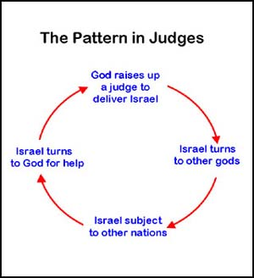
Second proof: We are fools.
The downward spiral pattern in Judges consists of the Israelite’s pride in their own knowledge and wisdom to the point they create situations of despair.
Instead of seeking the wisdom of God, they do what is pleasurable in their own eyes and in the end call out for deliverance.
Whether you want to admit it or not, we are all sinful.
Despite our past or current state, we have rebelled against the Lord because we sought what our eyes desired.
The Israelites were promised a peaceful dwelling place so long as they had faith in the Lord who was warring before them as they entered into the promised land. They lost sight of this promise.
They forgot about their relationship with God who had consistently proven to be a provider and deliverer.
God has not changed. He is still our provider and deliverer.

Slide 14

Second proof: We are fools.
How is your vision?
I am sure we are all familiar with the story of an individual who went multiple years, maybe into teen years or early adulthood, without wearing prescribed glasses despite their need for them.
What is the reaction when a semi-blind individual who thinks they see just fine has their eyes opened to the reality they have been missing out on?
The partially-blind misses the details of the leaves of the tree instead of thinking they’re just green blobs on the end of brown straight blurs.
The partially-blind misses the ability to walk confidently through the woods because of their fear of stumbling.

Slide 15
Second proof: We are fools.
Take a look at the pattern you have created in your life.
Do the results of your actions prove you are seeing clearly?
How much has the culture around you influenced your decision making in raising a family, spending your money, involvement in activities, people and places you hang out?
In all this be wise! Fear the Lord!

Slide 16
Third Proof: God sees you for what you are.
Romans 1:18-3:20 establishes the sinfulness of Jews and Gentiles.[1] All have sinned.
Whether you were raised with the Law or you were raised worshipping the pagan gods.
The same rings true for us today.
Whether we were raised in a spiritually focused home or we raised on witchcraft, humanism, or atheism we are all sinners just the same.
Romans 3:9-20 clearly establishes how God sees us. We are sinners. To deny our sinfulness is to deny the truth of the Word.
How is it that we could become so arrogant as to see our wisdom as more superior to HIS?
[1] Talbert, Charles H. "Paul on the Covenant." Review & Expositor 84, no. 2 (March 1, 1987), 303.

Slide 17
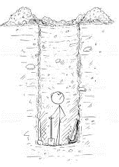
Third Proof: God sees you for what you are.
This lesson started out with the question of how we compare our wisdom to God’s.
The real question we need to be asking is not the comparison question, nor is it even how do we see God. The real scenario we need to evaluate is how does God see us?
What is His perspective of us?
Understanding God’s visual perception of mankind will provide a more accurate visual perception from us.
The reality of the situation is we are prone to doing evil.
The draw to sin is the pitfall of all of mankind.
God knows this to be true, which would explain His patience.
Time and time again God out stretches His arm to a rebellious people.

Slide 18
Third Proof: God sees you for what you are.
What is your beginning?
Whether you want to admit it or not, we are all fools.
From the beginning of our lives, what we see we want; we are selfish.
If we do not get what we want we throw a fit. If our fit does not work, we continue the cycle.
How does God see us?
In Ezekiel 16 there is an excellent description of the effort God put into our relationship. From the beginning when we were helpless (wallowing in our blood from birth) to the multiple times that we walk away from the relationship, HE WORKS in rebuilding the bond. The Lord God sees our helplessness and says, “LIVE!”[1]
[1] Ezekiel 16:6. I recommend reading this entire chapter for a fresh perspective of how God sees us. God has reached out to us in our darkest hour since sin entered the world.

Slide 19

Third Proof: God sees you for what you are.
It is important to note the logical structure within the catena (a connected series or chain of passages).
Osborne establishes an outline for Paul’s use of OT scripture, “the thesis of universal sin stated in verses 10-12 is followed by specific acts of sins – sins of speech (vv. 13-14) and of murder and its results (vv. 15-17) – and finally by the religious aspect of sin: no fear of God (v. 18, note the inclusion with the end of v. 11).” (Osborne, 87).
The fear of the Lord is the issue.
Without the fear of the Lord we focus on our own wisdom, morality, and righteousness to sail us through this life. As Christians, the fear of the Lord produces wisdom leading to righteousness through the blood of Jesus.
How does God see us?
We are children needing deliverance from our slavery of sin.
Do not be blinded by your pride and self-righteousness to miss this point.
How often have we heard the phrase, “I have some good news, and I have some bad news.”
Whenever someone presents this statement, it leaves us in suspense. Which one do you usually choose to hear first, the bad or the good?
In Romans, Paul has made it clear he has some bad news for the entire world, Jew and Gentile, you and me. The bad news: All have sinned. No matter what our background is, no matter what our families taught us, no matter how many “good things” we do, we are all sinners.
The good news is we can be freed from this sin if we open our eyes to the grace that is before us. Countless times God has revealed himself clearly. Do not be blinded by your own sin, worldview, and perspective to miss out on His glory.
Notes:
In Romans 3:9-20 Paul applies a method Rabbis would commonly use in their writing and argumentation.
Osborne identifies this method as “pearl-stringing.”[1]
Paul’s knowledge of the OT is vast. His citation in vs. 10-18 is proof of his Jewish up bringing.
Romans 3:10-18 contains Paul’s “lengthiest citation of Scripture in all of his letters.”[2]
Interestingly, Otto Michael presents an argument showing how vs.10-18 is derived from a circulating Psalm in the early church (something to consider).[3]
[1] Grant R. Osborne, “Romans,” The IVP NT Commentary, Vol 6 (Downers Grove, IL: InterVarsity Press, 2004), 86.
[2] Mark Seifrid, “Romans,” Commentary on the New Testament Use Of The Old Testament. Ed. G. K. Beale and D. A. Carson (Grand Rapids: Baker Academic, 2007), 616.
[3] Robert Jewett, “Romans,” Hermeneia (Minneapolis, MN: Fortress Press, 2007), 259.

Slide 20
Third Proof: God sees you for what you are.
Know your place before your gracious King, and your eyes will be opened to His wisdom.
The sooner we accept we cannot save ourselves, the sooner our wisdom will decrease and our eyes will be opened to His wisdom.
Be Wise! Fear the Lord!

Slide 21
Conclusion
Our wisdom falters before God’s wisdom.
Be Wise! Fear the Lord!
Until we comprehend our sinfulness, we will have a challenge of understanding God’s perception of us.
He knows what we are.
He knows from where we came.
He knows our deepest inward darkness.
He knows our deepest outward darkness.
Despite what He knows about our helpless depraved state He still reaches out to us because we are still valued in His perspective.
Have fear (reverence) for a God who knows what we are but still chooses to reach out to us.

